Slide 1
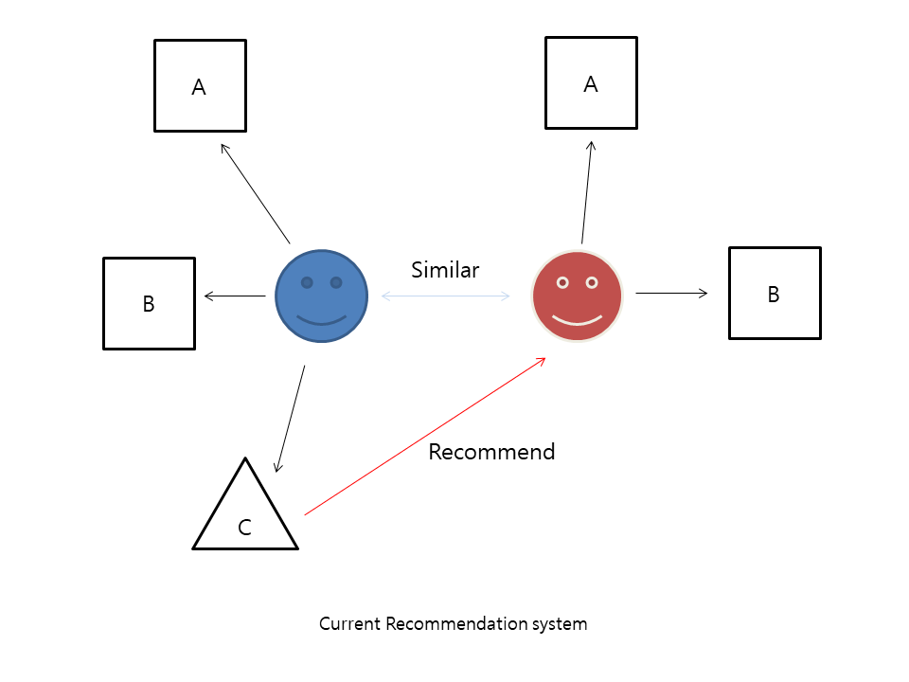
Current Recommendation system
Platform companies try to match similar people
People will only encounter parts that are similar and familiar to them.

Slide 2
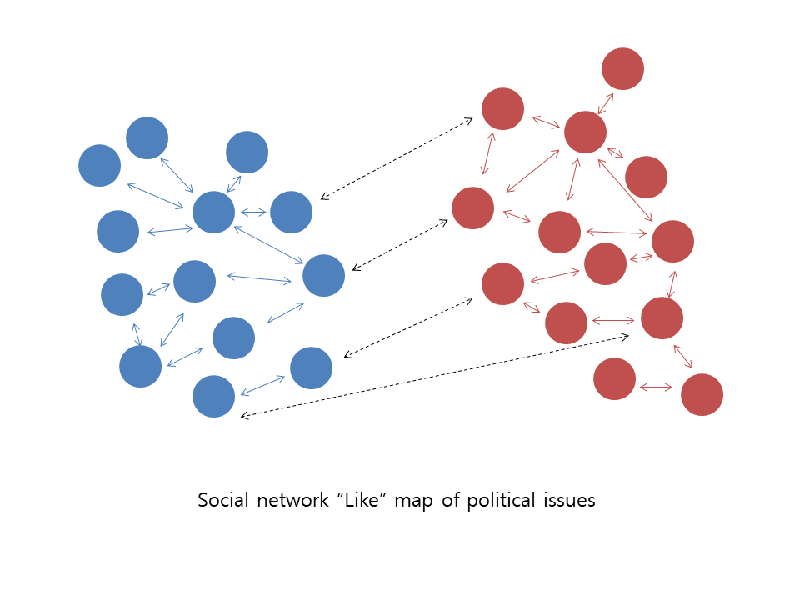
Social Networks make people radical?
- People like people who have the same thoughts as themselves
People easily agree with ideas similar to their own
This is reinforced in political issues
- There are political clusters in Social Network

Slide 3
How can we solve this problem?
Topic “social networking and automated contents recommendation are
making people more radical”
My opinion Pros
See Opinions
My Opinion I believe ~~~
3 Approves from Cons
I disagree with this statement because ~~
62 Approves from Pros
Add Objection
Fair enough!
I don’t think this statement is true because ~~
37 Approves from Pros
Add Objection
Fair enough!

Slide 4
How can we solve this problem?
When you write,
You carefully organize your logic and word choice
You establish your profile for recommendation and build influence level
When you read,
You meet different perspective on the topic
You can show appreciation for reasonable, persuasive opposing ideas
You develop a concrete moral with balanced view
You become a respectful debater
Forus is a place that different types of people know each other

Slide 5
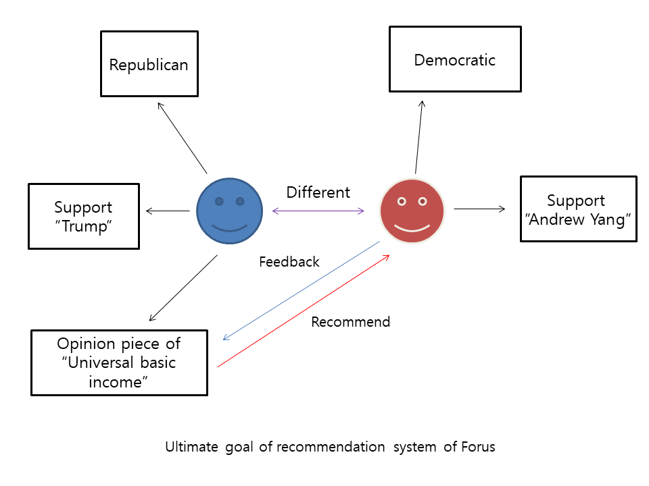
Ultimate goal of Forus system
Forus like map

Slide 6
Google survey
Do you think social networks make people radical?(Agree or Disagree)
(1) Reason to agree?
(2) Reason to disagree?
Do you think Forus new recommendation system can solve clustering problem in political issues?(Yes or No)
(1) Why do you think that Forus cannot solve the problem?(Only answer If he or she choose “No” in problem 2)
What is your primary interface for using social networks?(Android app, IOS app, Homepage in mobile, Homepage in computer)
Do you think people have been divided politically and ideologically in recent years?
Are you interested in using Forus if it is complete?(Yes or No)
(1) Why?
(2) Why not?
Forus has problem with (a. interface and design, b. main concept, c. lack of hooks(not fun), d etc)
(1) What is the problem?(only if he or she choose d.etc)
7. (Optional) Please give me ideas for improving Forus

